Slide 1
Introduction to TCP/IP

Slide 2
Table of Contents
A Brief History of TCP/IP
TCP/IP and the DoD Model
The Process/Application Layer Protocols
The Host-to-Host/Transport Layer Protocols
The Internet Layer Protocols

Slide 3
A Brief History of TCP/IP
1

Slide 4
A Brief History of TCP/IP
TCP/IP (Transmission Control Protocol/Internet Protocol) is a set of network protocols (Protocol Suite) that enable communication between computers
TCP first came on the scene in 1974
Divided into two distinct protocols, TCP and IP in 1978
Became the officials means of data transport for ARPANet in 1983
Mostly developed in UC Berkeley simultaneously with Berkeley version of UNIX (BSD)
Notes:
TCP/IP is a set of network protocols (Protocol Suite) that enable communication between computers. Network protocols are rules or standards that govern network communications. If two devices in a network need to communicate together, they need to use common set of network protocols. This can be compared with how humans speak. A French person cannot communicate with a Vietnamese person (without help from a translator) since they speak different languages.
You can select from different network protocols to use in your network, but TCP/IP is the industry standard. Almost all Operating Systems now support TCP/IP. Internet is working on TCP/IP. TCP/IP is known as "the language of the Internet". If you want your computer and computer live devices to work on the Internet, you have to use TCP/IP protocol suite.
The predecessor of today’s Internet was ARPAnet, created by the Advanced Research Projects Agency (ARPA) and launched in 1969 during "Cold War".
The protocol used on the ARPAnet was called Network Control Protocol (NCP). As the ARPAnet grew, however, a new protocol was needed because NCP was not able to fulfil all the needs of a larger network. In 1974 Vint Cerf and Bob Kahn, published a paper “A Protocol for Packet Network Interconnection.” This paper describes the Transmission Control Protocol (TCP), which eventually replaced NCP.
ARPAnet ceased to exist in 1990. The Internet has since grown from ARPAnet’s roots, and TCP/IP has evolved to meet the changing requirements of the Internet.

Slide 5
TCP/IP and the DoD Model
2

Slide 6
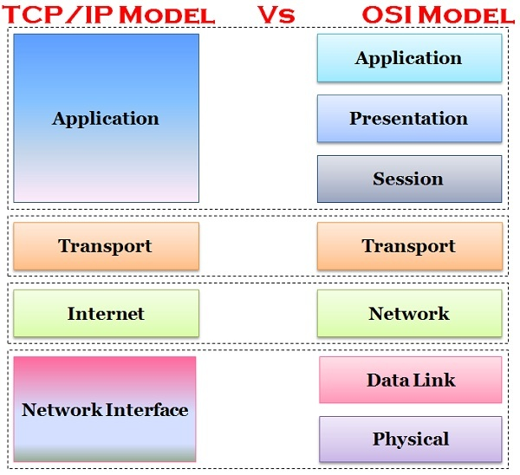
TCP/IP (DoD) and the OSI Model
The DoD (Department of Defense) created TCP/IP to ensure and preserve data integrity
The DoD model is a condensed version of the OSI model
Notes:
DoD modeli, OSI modelinin yoğunlaştırılmış bir versiyonudur.
DoD (Savunma Bakanlığı), veri bütünlüğünü sağlamak ve korumak için TCP/IP'yi oluşturdu

Slide 7
TCP/IP and the DoD Model
Network Access Layer
Defines details of how data is physically sent through the network
Main protocols are Ethernet, Token Ring, FDDI, X.25, and Frame Relay
FDDI: Fiber Distributed Data Interface
Notes:
Verilerin fiziksel olarak ağ üzerinden nasıl gönderildiğinin ayrıntılarını tanımlar
Ana protokoller Ethernet, Token Ring, FDDI, X.25 ve Frame Relay'dir.
Network Access Layer is the first layer of the four-layer TCP/IP model. Network Access Layer defines details of how data is physically sent through the network, including how bits are electrically or optically signaled by hardware devices that interface directly with a network medium, such as coaxial cable, optical fiber, or twisted pair copper wire.
The protocols included in Network Access Layer are Ethernet, Token Ring, FDDI, X.25, Frame Relay etc.

Slide 8
TCP/IP and the DoD Model
Internet Layer
Packs data into data packets known as IP datagrams
Responsible for routing of IP datagrams
Main protocols are IP, ICMP, ARP, RARP, and IGMP
IP: Internet Protocol
ICMP: Internet Control Message Protocol
ARP: Address Resolution Protocol
RARP: Reverse Address Resolution Protocol
IGMP: Internet Group Message Protocol
Notes:
Verileri IP datagramları olarak bilinen veri paketlerine paketler
IP datagramlarının yönlendirilmesinden sorumlu
Ana protokoller IP, ICMP, ARP, RARP ve IGMP'dir.
Internet Layer is the second layer of the four-layer TCP/IP model. The position of Internet layer is between Network Access Layer and Transport layer. Internet layer pack data into data packets known as IP datagrams, which contain source and destination address (logical address or IP address) information that is used to forward the datagrams between hosts and across networks. The Internet layer is also responsible for routing of IP datagrams.
Packet switching network depends upon a connectionless internetwork layer. This layer is known as Internet layer. Its job is to allow hosts to insert packets into any network and have them to deliver independently to the destination. At the destination side data packets may appear in a different order than they were sent. It is the job of the higher layers to rearrange them in order to deliver them to proper network applications operating at the Application layer.
The main protocols included at Internet layer are IP (Internet Protocol), ICMP (Internet Control Message Protocol), ARP (Address Resolution Protocol), RARP (Reverse Address Resolution Protocol) and IGMP (Internet Group Management Protocol).

Slide 9
TCP/IP and the DoD Model
Host-to-Host Layer (Transport Layer)
Permits devices on the source and destination to carry on a conversation
Defines the level of service and status of the connection used when transporting data
Main protocols are TCP and UDP
TCP: Transmission Control Protocol
UDP: User Datagram Protocol
Notes:
Kaynak ve hedefteki cihazların bir konuşmayı sürdürmesine izin verirVerileri taşırken kullanılan bağlantının hizmet düzeyini ve durumunu tanımlar
Ana protokoller TCP ve UDP'dir.
Host-to-Host Layer(or Transport Layer) is the third layer of the four-layer TCP/IP model. The position of the Transport layer is between Application layer and Internet layer. The purpose of Transport layer is to permit devices on the source and destination hosts to carry on a conversation. Transport layer defines the level of service and status of the connection used when transporting data.
The main protocols included at Transport layer are TCP (Transmission Control Protocol) and UDP (User Datagram Protocol).

Slide 10
TCP/IP and the DoD Model
Process/Application layer
Enables applications to communicate with each other.
Provides access to the services that operate at the lower layers of the DoD model.
It contains a protocol that implements user-level functions such as mail delivery, file transfer, and remote login.
Includes all higher-level protocols: DNS, HTTP, Telnet, SSH, FTP, SNMP, DHCP, etc.
DNS: Domain Name Service
HTTP: Hyper-text Transfer Protocol
SSH: Secure Shell
FTP: File Transfer Protocol
SNMP: Simple Network Management Protocol
DHCP: Dynamic Host Configuration Protocol
Notes:
Uygulamaların birbirleriyle iletişim kurmasını sağlar.
DoD modelinin alt katmanlarında çalışan hizmetlere erişim sağlar.
Posta teslimi, dosya aktarımı ve uzaktan oturum açma gibi kullanıcı düzeyinde işlevleri uygulayan bir protokol içerir.
Tüm üst düzey protokolleri içerir: DNS, HTTP, Telnet, SSH, FTP, SNMP, DHCP, vb.
DoD modelinin Uygulama katmanı, OSI modelinin üst üç katmanına, yani Oturum katmanı, Sunum katmanı ve Uygulama katmanına eşdeğerdir.
Savunma Bakanlığı modelinin İşlem/Uygulama katmanı aşağıdaki yetenekleri sağlar:Uygulamaların birbirleriyle iletişim kurmasını sağlayın.
DoD modelinin alt katmanlarında çalışan hizmetlere erişim sağlar.
Posta teslimi, dosya aktarımı ve uzaktan oturum açma gibi kullanıcı düzeyinde işlevleri uygulayan bir protokol içerir.Uygulama katmanı,
DNS (Etki Alanı Adlandırma Sistemi), HTTP (Köprü Metni Aktarım Protokolü), Telnet, SSH, FTP (Dosya Aktarım Protokolü), TFTP (Önemsiz Dosya Aktarım Protokolü), SNMP (Basit Ağ Yönetim Protokolü) gibi tüm üst düzey protokolleri içerir. , SMTP (Basit Posta Aktarım Protokolü), DHCP (Dinamik Ana Bilgisayar Yapılandırma Protokolü), X Windows, RDP (Uzak Masaüstü Protokolü) vb.
The Application layer of the DoD model is equivalent to the upper three layers of the OSI model, i.e., Session layer, Presentation layer, and Application layer. The Process/Application layer of the DoD model provides the following capabilities:
Enable applications to communicate with each other.
Provides access to the services that operate at the lower layers of the DoD model.
It contains a protocol that implements user-level functions such as mail delivery, file transfer, and remote login.
Application layer includes all the higher-level protocols like DNS (Domain Naming System), HTTP (Hypertext Transfer Protocol), Telnet, SSH, FTP (File Transfer Protocol), TFTP (Trivial File Transfer Protocol), SNMP (Simple Network Management Protocol), SMTP (Simple Mail Transfer Protocol) , DHCP (Dynamic Host Configuration Protocol), X Windows, RDP (Remote Desktop Protocol) etc.

Slide 11
The Transport Layer Protocols
TCP and UDP are the main protocols for Transport Layer
TCP is full-duplex, connection-oriented, reliable and accurate protocol
In order to send information, TCP establishes a connection with the receiving host (connection-oriented)
TCP takes information and breaks it into segments
TCP sends this segments in the order that application intended
After segments are sent TCP waits for the acknowledgement for each segment
Retransmits the segments that aren’t acknowledged (reliable)
Notes:
The main purpose of the Host-to-Host (or Transport) layer is to shield the upper-layer applications from the complexities of the network. This layer says to the upper layer, “Just give me your data stream, with any instructions, and I’ll begin the process of getting your information ready to send.”
The followings are the two protocols at this layer:
Transmission Control Protocol (TCP)
User Datagram Protocol (UDP)
Transmission Control Protocol (TCP) takes large blocks of information from an application and breaks them into segments. It numbers and sequences each segment so that the destination’s TCP process can put the segments back into the order the application intended. After these segments are sent, TCP (on the transmitting host) waits for an acknowledgment from the receiving end’s TCP process, retransmitting those segments that aren’t acknowledged.
Remember that in reliable transport operation, a device that wants to transmit sets up a connection-oriented communication with a remote device by creating a session. The transmitting device first establishes a connection-oriented session with its peer system; that session is called a call setup or a three-way handshake. Data is then transferred, and when the transfer is complete, a call termination takes place to tear down the virtual circuit.
TCP is a full-duplex, connection-oriented, reliable, and accurate protocol, but establishing all these terms and conditions, in addition to error checking, is no small task. TCP is very complicated and costly in terms of network overhead.

Slide 12
The Transport Layer Protocols
UDP uses less bandwidth compared to TCP
UDP transports data much faster than TCP
UDP doesn’t care the order of the segments
UDP doesn’t care if the segment is received by the recipient (no acknowledgement) (not reliable)
UDP doesn’t establish a connection with the receiver (connectionless protocol)
Mostly used while speed is more important than reliability (like video teleconferencing or SNMP)
Notes:
If to compare User Datagram Protocol (UDP) with TCP, the former is basically the scaled-down economy model that’s sometimes referred to as a thin protocol. A thin protocol doesn’t take up much bandwidth on a network. UDP doesn’t offer all the advantages of TCP either, but it does do a fabulous job of transporting information that doesn’t require reliable delivery—and it does so using far fewer network resources.
There are some situations in which it would definitely be wise for developers to opt for UDP rather than TCP. Remember the watchdog SNMP up there at the Process/Application layer. SNMP monitors the network, sending intermittent messages and a fairly steady flow of status updates and alerts, especially when running on a large network. The cost in overhead to establish, maintain, and close a TCP connection for each one of those little messages would reduce what would be an otherwise healthy, efficient network.
Another circumstance calling for UDP over TCP is when reliability is already handled at the Process/Application layer. DNS handles its own reliability issues, making the use of TCP both impractical and redundant. But ultimately, it’s up to the application developer to decide whether to use UDP or TCP, not the user who wants to transfer data faster.
UDP does not sequence the segments and doesn’t care in which order the segments arrive at the destination. But after that, UDP sends the segments off and forgets about them. It doesn’t follow through, check up on them, or even allow for an acknowledgment of safe arrival—complete abandonment. Because of this, it’s referred to as an unreliable protocol. This doesn’t mean that UDP is ineffective, only that it doesn’t handle issues of reliability. Because UDP assumes that the application will use its own reliability method, it doesn’t use any. This gives an application developer a choice when running the IP stack: TCP for reliability or UDP for faster transfers.
Further, UDP doesn’t create a virtual circuit, nor does it contact the destination before delivering information to it. Because of this, it’s also considered a connectionless protocol.

Slide 13
The Transport Layer Protocols
TCP | UDP
Secure | Unsecure
Connection-oriented | Connectionless
Slow | Fast
Guaranteed transmission | No guarantee
Flow control | No flow control
Reliable | Unreliable
Virtual circuit | No virtual circuit
Acknowledgement | No acknowledgement
20 bytes header | 8 bytes header
Notes:
Comparison table of TCP and UDP

Slide 14
The Internet Layer Protocols
5

Slide 15
The Internet Layer Protocols
Main functions: routing and providing a single network interface to upper layers
Main protocols:
Internet Protocol (IP)
Internet Control Message Protocol (ICMP)
Address Resolution Protocol (ARP)
Reverse Address Resolution Protocol (RARP)
Notes:
In the DoD model, there are two main reasons for the Internet layer’s existence: routing and providing a single network interface to the upper layers.
None of the other upper- or lower-layer protocols have any functions relating to routing—that complex and important task belongs entirely to the Internet layer. The Internet layer’s second duty is to provide a single network interface to the upper-layer protocols.
All network depends on IP. And all the other protocols at this layer, as well as all those at the upper layers, use it. Never forget that. All paths through the DoD model go through IP. The following sections describe the protocols at the Internet layer:
Internet Protocol (IP)
Internet Control Message Protocol (ICMP)
Address Resolution Protocol (ARP)
Reverse Address Resolution Protocol (RARP)

Slide 16
The Internet Layer Protocols
Internet Protocol (IP) looks at each packet’s destination address, then, using a routing table, it decides where a packet is to be sent next, choosing the best path.
To find the receiver host, sender has to find out:
On which network is the receiver located?
What is its id?
1
2
Software address
MAC address
Notes:
IP looks at each packet’s destination address. Then, using a routing table, it decides where a packet is to be sent next, choosing the best path. The protocols of the Network Access layer at the bottom of the DoD model don’t possess IP’s enlightened scope of the entire network; they deal only with physical links (local networks).
Identifying devices on networks requires answering these two questions: Which network is it on? And what is its ID on that network? The answer to the first question is the software address, or logical address. The answer to the second question is the hardware address. All hosts on a network have a logical ID called an IP address. This is the software, or logical, address and contains valuable encoded information, greatly simplifying the complex task of routing.
IP receives segments from the Host-to-Host layer and fragments them into packets if necessary. IP then reassembles packets back into segments on the receiving side. Each packet is assigned the IP address of the sender and of the recipient. Each router (Layer 3 device) that receives a packet makes routing decisions based on the packet’s destination IP address.

Slide 17
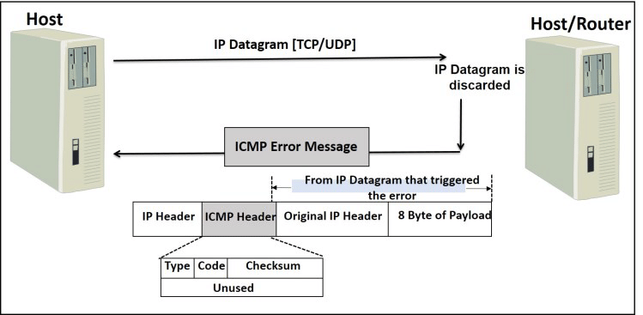
The Internet Layer Protocols
Internet Control Message Protocol (ICMP) is a management protocol and messaging service provider for IP
ICMP messages are sent as IP packets
Common events that ICMP relates to:
Destination unreachable
Buffer full
Hops
Ping and Traceroute use ICMP
Notes:
Internet Control Message Protocol (ICMP) works at the Network layer and is used by IP for many different services. ICMP is a management protocol and messaging service provider for IP. Its messages are carried as IP packets. They are encapsulated within IP datagrams.
They can provide hosts with information about network problems.
The following are some common events and messages that ICMP relates to:
Destination Unreachable - If a router can’t send an IP datagram any further, it uses ICMP to send a message back to the sender, advising it of the situation. For example, the below figure shows that the Ethernet interface of the Lab B router is down.
ICMP error message is sent to the sending host from the remote router.
When Host A sends a packet destined for Host B, the Lab B router will send an ICMP Destination Unreachable message back to the sending device.
Buffer Full - If a router’s memory buffer for receiving incoming datagrams is full, it will use ICMP to send out this message until the congestion abates.
Hops - Each IP datagram is allotted a certain number of routers, called hops, to pass through. If a datagram reaches its limit of hops before arriving at its destination, the last router to receive it deletes it. The executioner router then uses ICMP to send an obituary message, informing the sending machine of the demise of its datagram.
The two most popular programs that use ICMP:
Ping - Ping uses ICMP echo request and reply messages to check the physical and logical connectivity of machines on an internetwork.
Traceroute - Traceroute uses IP packet Time to Live time-outs to discover the path a packet takes as it traverses an internetwork.

Slide 18
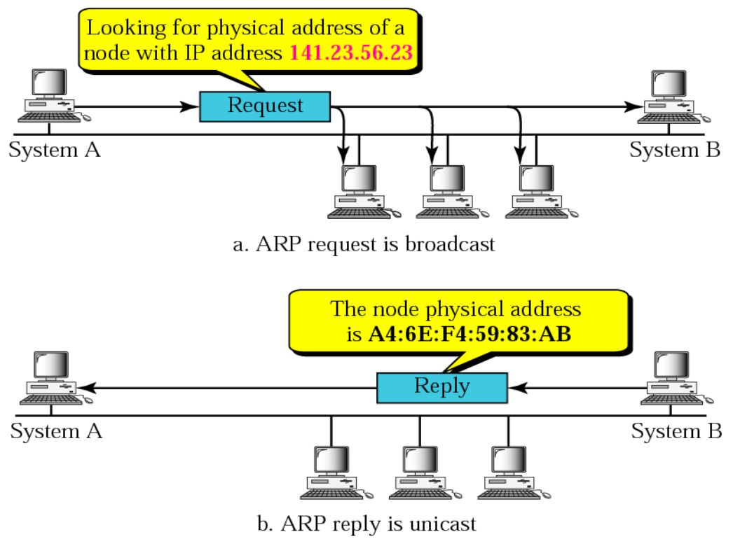
The Internet Layer Protocols
Address Resolution Protocol (ARP) is a procedure for mapping a dynamic IP address to a permanent physical machine address in a LAN
Essentially matches
IPv4 Address
32-bit
MAC Address
48-bit
Notes:
Address Resolution Protocol (ARP) is a procedure for mapping a dynamic Internet Protocol address (IP address) to a permanent physical machine address in a local area network (LAN). The physical machine address is also known as a Media Access Control or MAC address.
The job of the ARP is essentially to translate 32-bit addresses to 48-bit addresses and vice-versa. This is necessary because in IP Version 4 (IPv4), the most common level of Internet Protocol (IP) in use today, an IP address is 32-bits long, but MAC addresses are 48-bits long.
All operating systems in an IPv4 Ethernet network keep an ARP cache. Every time a host requests a MAC address in order to send a packet to another host in the LAN, it checks its ARP cache to see if the IP to MAC address translation already exists. If it does, then a new ARP request is unnecessary. If the translation does not already exist, then the request for network addresses is sent and ARP is performed.
ARP broadcasts a request packet to all the machines on the LAN and asks if any of the machines know they are using that particular IP address. When a machine recognizes the IP address as its own, it sends a reply so ARP can update the cache for future reference and proceed with the communication.

Slide 19
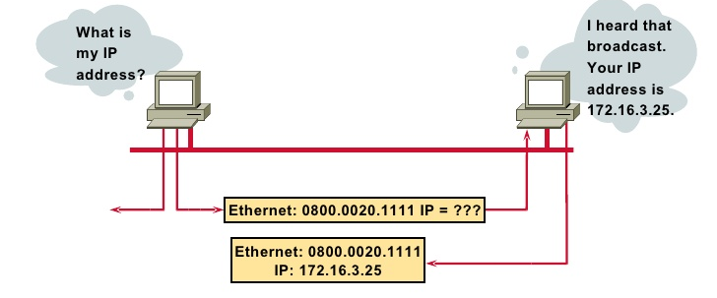
The Internet Layer Protocols
Host machines that don't know their own IP address can use the Reverse ARP (RARP) protocol for discovery
ARP is replaced by Neighbor Discovery Protocol with the use of IPv6
Notes:
Address Resolution Protocol (ARP) is a procedure for mapping a dynamic Internet Protocol address (IP address) to a permanent physical machine address in a local area network (LAN). The physical machine address is also known as a Media Access Control or MAC address.
The job of the ARP is essentially to translate 32-bit addresses to 48-bit addresses and vice-versa. This is necessary because in IP Version 4 (IPv4), the most common level of Internet Protocol (IP) in use today, an IP address is 32-bits long, but MAC addresses are 48-bits long.

Slide 20
The Process/Application Layer Protocols
3

Slide 21
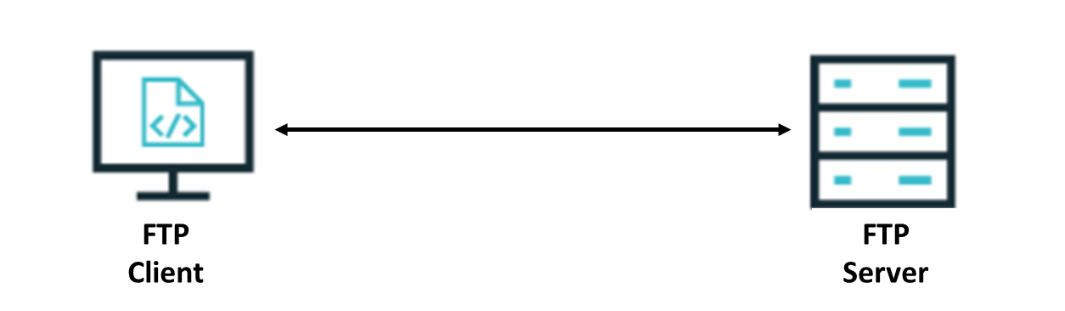
FTP Protocol
File Transfer Protocol lets us transfer files between any two machines.
Uses TCP protocol on port 20 and 21
FTP functions are limited to listing and manipulating directories, typing file contents, and copying files between hosts.
Notes:
FTP (TCP 20, 21): File Transfer Protocol lets us transfer files, and it can accomplish this between any two machines using it. FTP allows access to both directories and files and can accomplish certain types of directory operations, such as relocating into different ones. FTP functions are limited to listing and manipulating directories, typing file contents, and copying files between hosts.

Slide 22
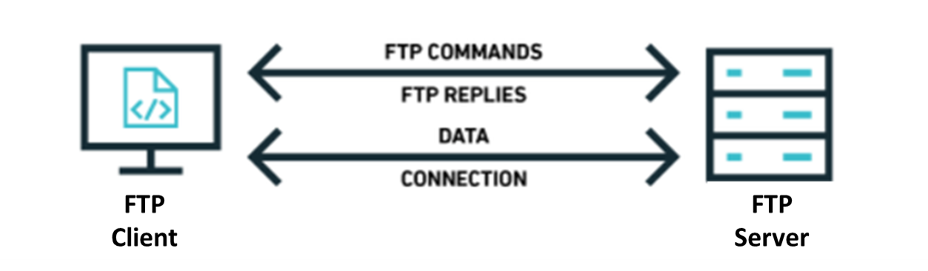
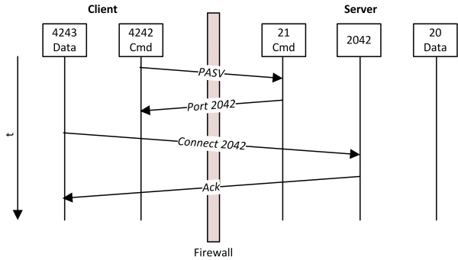
FTP Protocol Elements
Channels
Data
Connection (control)
Data Structures
File, Record, Page
FTP Commands
USER
PASS
LIST
MKD
…
FTP Replies
200 - Okay
530 - Not logged in
225 - Data connection open; no transfer in progress
…

Slide 23
Other File Transfer Protocols
Name | TCP/UDP | Port | Description
FTPS | TCP | 20/21 | FTP Secure is an extension of FTP that adds support for TLS encryption.
TFTP | UDP | 69 | Trivial FTP is the stripped-down, stock version of FTP. TFTP is fast and so easy to use. It can only send and receive files.
SFTP | TCP | 22 | Same as FTP but Secure FTP uses an encrypted connection through an SSH session, which encrypts the connection.
Notes:
TFTP (UDP 69): Önemsiz Dosya Aktarım Protokolü (TFTP), FTP'nin sadeleştirilmiş, stok sürümüdür.
TFTP hızlıdır ve kullanımı çok kolaydır. TFTP, FTP'nin sunduğu çok sayıda işlevi sunmaz çünkü dizin tarama yetenekleri yoktur,
yani yalnızca dosya gönderip alabilir.SFTP (TCP 22): Dosyaları şifreli bir bağlantı üzerinden aktarmanız gerektiğinde Güvenli Dosya Aktarım Protokolü kullanılır. Bağlantıyı şifreleyen bir SSH oturumu kullanır ve SSH 22 numaralı bağlantı noktasını kullanır, dolayısıyla 22 numaralı bağlantı noktası SFTP için kullanılır. Güvenli bölümün dışında, tıpkı FTP gibi, Internet gibi bir IP ağındaki bilgisayarlar arasında dosya aktarımı için kullanılır.
TFTP (UDP 69): Trivial File Transfer Protocol (TFTP) is the stripped-down, stock version of FTP. TFTP is fast and so easy to use. TFTP doesn’t offer the abundance of functions that FTP does because it has no directory-browsing abilities, meaning that it can only send and receive files.
SFTP (TCP 22): Secure File Transfer Protocol is used when you need to transfer files over an encrypted connection. It uses an SSH session, which encrypts the connection, and SSH uses port 22, hence the port 22 is used for SFTP. Apart from the secure part, it’s used just as FTP is—for transferring files between computers on an IP network, such as the Internet.

Slide 24
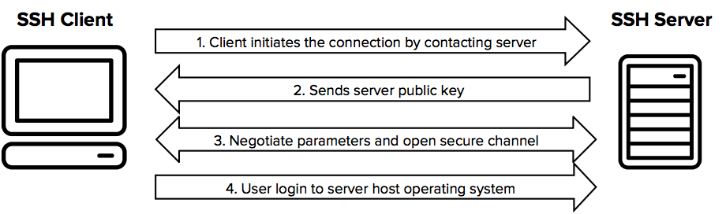
SSH Protocol
Secure Shell protocol creates a secure connection to enable users to execute commands on remote machines
Uses TCP Port 22
Notes:
FTP (TCP 20, 21): Dosya Aktarım Protokolü, dosyaları aktarmamızı sağlar ve bunu kullanan herhangi iki makine arasında gerçekleştirebilir. FTP, hem dizinlere hem de dosyalara erişim sağlar ve farklı dizinlere yeniden yerleştirme gibi belirli türdeki dizin işlemlerini gerçekleştirebilir. FTP işlevleri, dizinleri listeleme ve değiştirme, dosya içeriklerini yazma ve ana bilgisayarlar arasında dosya kopyalama ile sınırlıdır.
FTP (TCP 20, 21): File Transfer Protocol lets us transfer files, and it can accomplish this between any two machines using it. FTP allows access to both directories and files and can accomplish certain types of directory operations, such as relocating into different ones. FTP functions are limited to listing and manipulating directories, typing file contents, and copying files between hosts.

Slide 25
Other Remote Access Protocols
Name | TCP/UDP | Port | Description
Telnet | TCP | 23 | Teletype Network Protocol allows a user on a remote client machine to access the resources of another machine. Uses plain text communication.
RDP | TCP | 3389 | Remote Desktop Protocol is a proprietary protocol developed by Microsoft. It allows you to connect to another computer and run programs. Windows, and Macs now come with a preinstalled RDP client.
Notes:
Telnet (TCP 23): Telnet allows a user on a remote client machine, called the Telnet Client, to access the resources of another machine. The drawback of Telnet is that there are no encryption techniques available within the Telnet Protocols, so everything must be sent in the cleartext.
RDP (TCP 3389): Remote Desktop Protocol is a proprietary protocol developed by Microsoft. It allows you to connect to another computer and run programs. RDP operates somewhat like Telnet, except instead of getting a command-line prompt as you do with Telnet, you get the actual graphical user interface (GUI) of the remote computer. Clients exist for most versions of Windows, and Macs now come with a preinstalled RDP client. Microsoft currently calls its official RDP server software Remote Desktop Services. Microsoft’s official client software is currently referred to as Remote Desktop Connection. RDP is an excellent tool for remote clients, allowing them to connect to their work computer from home, for example, and get their email or perform work on other applications without running or installing any of the software on their home computer.

Slide 26
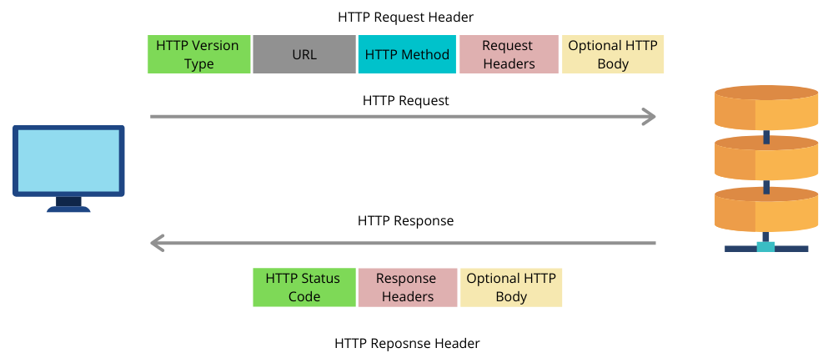
HTTP and HTTPS Protocols
Hypertext Transfer Protocol (HTTP) is used for communication between clients and web servers
Uses TCP Port 80
HTTPS adds encryption via TLS (or SSL) and instead uses port 443
Example Methods:
GET
POST
…
Example Response Codes
200: The request was successful
404: Page not found
Notes:
HTTPS protokolünü kullanabilmesi için gerekli olan SSL Sertifikası bağlanılmak istenen sitenin kimliğini doğrulama işlemi için kullanılmaktadır. Tarayıcı ve sunucu arasında şifreli bir bağlantı elde etmek için sunucuya ekleyeceğiniz veri dosyalarına verilen sertifikayı etkinleştirdiğinizde sitenizi ziyaret eden kullanıcılar yeşil bir asma kilit şekli ile karşılaşacaktır. Bu şekil sitenizin güvenli olduğu anlamına gelmektedir. Sertifika web tarayıcı sistemleriyle yıllık olarak ücretlendirilir
HTTP şifresiz çalıştığından tüm bilgiler açık metin olarak gönderilmektedir. Ancak HTTPS protokolü bağlantılarda gizli dinlemeyi önlemek amacıyla kullanılabilmektedir
Ücretsiz SSL sertifikası nasıl alırım?
SSL Sertifikası Nasıl Alınır? Ücretsiz SSL sertifikası, Let's Encrypt, SSL for free, CAcert, Sectigo gibi web sitesi ve kuruluşlardan alınmaktadır ayrıca son zamanlarda bazı hosting firmaları da ücretsiz SSL hizmeti sunmaya başlamıştır. Ücretli SSL sertifikaları ise hosting firmaları tarafından sağlanmaktadır.
HTTP (TCP 80): Hypertext Transfer Protocol is used to manage communications between web browsers and web servers and opens the right resources when you click a link, wherever that resource may reside.
HTTPS (TCP 4743): Hypertext Transfer Protocol Secure is also known as a secure Hypertext Transfer Protocol. It uses the Secure Socket Layer (SSL). It is the secure version of the HTTP that arms us with a whole bunch of security tools for keeping transactions between web browsers and servers secure. It is what our browser needs to fill out forms, sign in, authenticate, and encrypt an HTTP message when we do things like making an online reservation, accessing online banking, or buying something online.

Slide 27

Email Protocols
Name | TCP/UDP | Port | Description
POP | TCP | 110 | Post Office Protocol gives us a storage facility for incoming mail (the latest version is POP3). A newer standard, IMAP, is being used more and more in place of POP3.
IMAP | TCP | 143 | Internet Message Access Protocol makes it so you get control over how you download your mail, with it, you also gain some much-needed security. It has some serious authentication features. IMAP4 is the current version.
Notes:
POP (TCP 110): Post Office Protocol gives us a storage facility for incoming mail, and the latest version is called POP3. How this protocol works is when a client device connects to a POP3 server, messages addressed to that client are released for download. It doesn’t allow messages to be downloaded selectively, but once they are, the client-server interaction ends and you can delete and tweak your messages locally at will. A newer standard, IMAP, is being used more and more in place of POP3.
IMAP (TCP 143): Because Internet Message Access Protocol (IMAP) makes it so you get control over how you download your mail, with it, you also gain some much-needed security. It lets you peek at the message header or download just a part of a message. With it, you can choose to store messages on the email server hierarchically and link to documents and user groups, too. IMAP even gives you search commands to use to hunt for messages based on their subject, header, or content. As you can imagine, it has some serious authentication features—it supports the Kerberos authentication scheme that MIT developed. IMAP4 is the current version.

Slide 28


Multimedia Protocols
Name | TCP/UDP | Port | Description
SIP (VoIP) | TCP or UDP | 5060 or 5061 | Session Initiation Protocol is a popular protocol used to for multimedia communication sessions for many things like voice and video calls, streaming, instant messaging, and online games over the Internet.
RTP (VoIP) | UDP TCP | 5004 5005 | Real-time Transport Protocol describes a packet-formatting standard for delivering audio and video over the Internet.
MGCP | TCP | 2427 2727 | Media Gateway Control Protocol is a standard protocol for handling the signaling and session management needed during a multimedia conference.
H.323 | TCP | 1720 | H.323 is a protocol that provides a standard for video on an IP network that defines how real-time audio, video, and data information is transmitted.
Notes:
SIP (VoIP) (TCP or UDP 5060/TCP 5061): Session Initiation Protocol is a hugely popular signaling protocol used to construct and deconstruct multimedia communication sessions for many things like voice and video calls, videoconferencing, streaming multimedia distribution, instant messaging, presence information, and online games over the Internet.
RTP (VoIP) (UDP 5004/TCP 5005): Real-time Transport Protocol describes a packet-formatting standard for delivering audio and video over the Internet. Although initially designed as a multicast protocol, it’s now used for unicast applications, too. It’s commonly employed for streaming media, videoconferencing, and push-to-talk systems—all things that make it a de facto standard in Voice over IP (VoIP) industries.
MGCP (Multimedia) (TCP 2427/2727): Media Gateway Control Protocol is a standard protocol for handling the signaling and session management needed during a multimedia conference. The protocol defines a means of communication between a media gateway, which converts data from the format required for a circuit-switched network to that required for a packet-switched network, and the media gateway controller. MGCP can be used to set up, maintain, and terminate calls between multiple endpoints.
H.323 (Video) (TCP 1720): H.323 is a protocol that provides a standard for video on an IP network that defines how real-time audio, video, and data information is transmitted. This standard provides signaling, multimedia, and bandwidth control mechanisms. H.323 uses the RTP standard for communication.

Slide 29

Utility Protocols
Name | TCP/UDP | Port | Description
SNMP | UDP TCP | 161 25 | Simple Network Management Protocol collects and manipulates valuable network information. It gathers data by polling the devices on the network. This protocol can also stand as a watchdog over the network or simplify network management.
NTP | UDP | 123 | Network Time Protocol is used to synchronize the clocks on our computer to one standard time source. This protocol works by synchronizing devices to ensure that all the computers on a given network agree on the time.
Notes:
SNMP (UDP 161/TCP 25): Simple Network Management Protocol collects and manipulates valuable network information. It gathers data by polling the devices on the network from a management station at fixed or random intervals, requiring them to disclose certain information. When all is well, SNMP receives something called a baseline—a report delimiting the operational traits of a healthy network. This protocol can also stand as a watchdog over the network, quickly notifying managers of any sudden turn of events. The network watchdogs are called agents, and when aberrations occur, agents send an alert called a trap to the management station. Besides, SNMP can help simplify the process of setting up a network as well as the administration of your entire internetwork.
NTP (UDP 123): Network Time Protocol is used to synchronize the clocks on our computer to one standard time source. This protocol works by synchronizing devices to ensure that all the computers on a given network agree on the time.

Slide 30
DHCP
DHCP (UDP 67/68): Dynamic Host Configuration Protocol assigns IP Address to hosts. It allows for easier administration and works well in small to very large network environments. Many types of hardware can be used as a DHCP Server, including a Cisco Router. There is a lot of information a DHCP server can provide to a host when the host is requesting an IP address from DHCP Server like
IP Address
Subnet Mask
Domain Name
Default Gateways
DNS Server Address
Notes:
DHCP (UDP 67/68): Dynamic Host Configuration Protocol assigns IP Address to hosts. It allows for easier administration and works well in small to very large network environments. Many types of hardware can be used as a DHCP Server, including a Cisco Router. There is a lot of information a DHCP server can provide to a host when the host is requesting an IP address from DHCP Server, here is the list of some common types of information a DHCP server can provide:
IP Address
Subnet Mask
Domain Name
Default Gateways
DNS Server Address

Slide 31
LDAP
LDAP (TCP 389): Lightweight Directory Access Protocol standardizes how you access directories.
Notes:
LDAP (TCP 389): If you’re the system administrator of any decent-sized network, odds are you have a type of directory in place that keeps track of all your network resources, such as devices and users. You can do this through the Lightweight Directory Access Protocol. This protocol standardizes how you access directories, and Introducing TCP/IP 185 its first and second inceptions are described in RFCs 1487 and 1777, respectively. There were a few glitches in those two earlier versions, so a third version—the one most commonly used today—was created to address those issues and is described in RFC 3377.

Slide 32
Encryption Protocols
TLS/SSL: Both Transport Layer Security and its forerunner, Secure Sockets Layer, are cryptographic protocols that are useful for enabling secure online data-transfer activities like browsing the Web, instant messaging, Internet faxing, and so on.
Notes:
TLS/SSL: Both Transport Layer Security and its forerunner, Secure Sockets Layer, are cryptographic protocols that are useful for enabling secure online data-transfer activities like browsing the Web, instant messaging, Internet faxing, and so on. They’re so similar. They both use X.509 certificates and asymmetric cryptography to authenticate to the host they are communicating with and to exchange a key. This key is then used to encrypt data flowing between the hosts. This allows for data/message confidentiality, message integrity, and message authentication.

Slide 33
The Process/Application Layer Protocols
Telnet (TCP 23): Allows a user on a remote client machine to access the resources of another machine.
SSH (TCP 22): Secure Shell Protocol sets up a secure session that’s similar to Telnet over a standard TCP/IP connection and is employed for doing things like logging into systems, running programs on remote systems and moving file from one system to another system.
Notes:
Telnet (TCP 23): Telnet allows a user on a remote client machine, called the Telnet Client, to access the resources of another machine. The drawback of Telnet is that there are no encryption techniques available within the Telnet Protocols, so everything must be sent in the cleartext.

Slide 34
The Process/Application Layer Protocols
FTP (TCP 20, 21): File Transfer Protocol lets us transfer files between any two machines. FTP functions are limited to listing and manipulating directories, typing file contents, and copying files between hosts.
SFTP (TCP 22): Same as FTP but Secure FTP uses an encrypted connection through an SSH session, which encrypts the connection.
TFTP (UDP 69): Trivial FTP is the stripped-down, stock version of FTP. TFTP is fast and so easy to use. It can only send and receive files.
Notes:
Telnet (TCP 23): Telnet allows a user on a remote client machine, called the Telnet Client, to access the resources of another machine. The drawback of Telnet is that there are no encryption techniques available within the Telnet Protocols, so everything must be sent in the cleartext.
FTP (TCP 20, 21): File Transfer Protocol lets us transfer files, and it can accomplish this between any two machines using it. FTP allows access to both directories and files and can accomplish certain types of directory operations, such as relocating into different ones. FTP functions are limited to listing and manipulating directories, typing file contents, and copying files between hosts.
SFTP (TCP 22): Secure File Transfer Protocol is used when you need to transfer files over an encrypted connection. It uses an SSH session, which encrypts the connection, and SSH uses port 22, hence the port 22 is used for SFTP. Apart from the secure part, it’s used just as FTP is—for transferring files between computers on an IP network, such as the Internet.

Slide 35
The Process/Application Layer Protocols
POP (TCP 110): Post Office Protocol gives us a storage facility for incoming mail (the latest version is POP3). A newer standard, IMAP, is being used more and more in place of POP3.
IMAP (TCP 143): Internet Message Access Protocol makes it so you get control over how you download your mail, with it, you also gain some much-needed security. It has some serious authentication features. IMAP4 is the current version.
Notes:
TFTP (UDP 69): Trivial File Transfer Protocol (TFTP) is the stripped-down, stock version of FTP. TFTP is fast and so easy to use. TFTP doesn’t offer the abundance of functions that FTP does because it has no directory-browsing abilities, meaning that it can only send and receive files.
POP (TCP 110): Post Office Protocol gives us a storage facility for incoming mail, and the latest version is called POP3. How this protocol works is when a client device connects to a POP3 server, messages addressed to that client are released for download. It doesn’t allow messages to be downloaded selectively, but once they are, the client-server interaction ends and you can delete and tweak your messages locally at will. A newer standard, IMAP, is being used more and more in place of POP3.
IMAP (TCP 143): Because Internet Message Access Protocol (IMAP) makes it so you get control over how you download your mail, with it, you also gain some much-needed security. It lets you peek at the message header or download just a part of a message. With it, you can choose to store messages on the email server hierarchically and link to documents and user groups, too. IMAP even gives you search commands to use to hunt for messages based on their subject, header, or content. As you can imagine, it has some serious authentication features—it supports the Kerberos authentication scheme that MIT developed. IMAP4 is the current version.

Slide 36
The Process/Application Layer Protocols
RDP (TCP 3389): Remote Desktop Protocol is a proprietary protocol developed by Microsoft. It allows you to connect to another computer and run programs. Windows, and Macs now come with a preinstalled RDP client.
TLS/SSL (TCP 995/465): Both Transport Layer Security and its forerunner, Secure Sockets Layer, are cryptographic protocols that are useful for enabling secure online data-transfer activities like browsing the Web, instant messaging, Internet faxing, and so on.
Notes:
RDP (TCP 3389): Remote Desktop Protocol is a proprietary protocol developed by Microsoft. It allows you to connect to another computer and run programs. RDP operates somewhat like Telnet, except instead of getting a command-line prompt as you do with Telnet, you get the actual graphical user interface (GUI) of the remote computer. Clients exist for most versions of Windows, and Macs now come with a preinstalled RDP client. Microsoft currently calls its official RDP server software Remote Desktop Services. Microsoft’s official client software is currently referred to as Remote Desktop Connection. RDP is an excellent tool for remote clients, allowing them to connect to their work computer from home, for example, and get their email or perform work on other applications without running or installing any of the software on their home computer.
TLS/SSL (TCP 995/465): Both Transport Layer Security and its forerunner, Secure Sockets Layer, are cryptographic protocols that are useful for enabling secure online data-transfer activities like browsing the Web, instant messaging, Internet faxing, and so on. They’re so similar. They both use X.509 certificates and asymmetric cryptography to authenticate to the host they are communicating with and to exchange a key. This key is then used to encrypt data flowing between the hosts. This allows for data/message confidentiality, message integrity, and message authentication.

Slide 37
The Process/Application Layer Protocols
SIP (VoIP) (TCP or UDP 5060/TCP 5061): Session Initiation Protocol is a hugely popular protocol used to construct and deconstruct multimedia communication sessions for many things like voice and video calls, video conferencing, streaming multimedia distribution, instant messaging, presence information, and online games over the Internet.
RTP (VoIP) (UDP 5004/TCP 5005): Real-time Transport Protocol describes a packet-formatting standard for delivering audio and video over the Internet.
Notes:
SIP (VoIP) (TCP or UDP 5060/TCP 5061): Session Initiation Protocol is a hugely popular signaling protocol used to construct and deconstruct multimedia communication sessions for many things like voice and video calls, videoconferencing, streaming multimedia distribution, instant messaging, presence information, and online games over the Internet.
RTP (VoIP) (UDP 5004/TCP 5005): Real-time Transport Protocol describes a packet-formatting standard for delivering audio and video over the Internet. Although initially designed as a multicast protocol, it’s now used for unicast applications, too. It’s commonly employed for streaming media, videoconferencing, and push-to-talk systems—all things that make it a de facto standard in Voice over IP (VoIP) industries.

Slide 38
The Process/Application Layer Protocols
MGCP (Multimedia) (TCP 2427/2727): Media Gateway Control Protocol is a standard protocol for handling the signaling and session management needed during a multimedia conference.
H.323 (Video) (TCP 1720): H.323 is a protocol that provides a standard for video on an IP network that defines how real-time audio, video, and data information is transmitted.
Notes:
MGCP (Multimedia) (TCP 2427/2727): Media Gateway Control Protocol is a standard protocol for handling the signaling and session management needed during a multimedia conference. The protocol defines a means of communication between a media gateway, which converts data from the format required for a circuit-switched network to that required for a packet-switched network, and the media gateway controller. MGCP can be used to set up, maintain, and terminate calls between multiple endpoints.
H.323 (Video) (TCP 1720): H.323 is a protocol that provides a standard for video on an IP network that defines how real-time audio, video, and data information is transmitted. This standard provides signaling, multimedia, and bandwidth control mechanisms. H.323 uses the RTP standard for communication.
SSH (TCP 22): Secure Shell Protocol sets up a secure session that’s similar to Telnet over a standard TCP/IP connection and is employed for doing things like logging into systems, running programs on remote systems and moving file from one system to another system. And it does all this while maintaining an encrypted connection.

Slide 39
The Process/Application Layer Protocols
SNMP (UDP 161/TCP 25): Simple Network Management Protocol collects and manipulates valuable network information. It gathers data by polling the devices on the network from a management station at fixed or random intervals, requiring them to disclose certain information. This protocol can also stand as a watchdog over the network, quickly notifying managers of any sudden turn of events. Besides, SNMP can help simplify the process of setting up a network as well as the administration of your entire internetwork.
Notes:
SNMP (UDP 161/TCP 25): Simple Network Management Protocol collects and manipulates valuable network information. It gathers data by polling the devices on the network from a management station at fixed or random intervals, requiring them to disclose certain information. When all is well, SNMP receives something called a baseline—a report delimiting the operational traits of a healthy network. This protocol can also stand as a watchdog over the network, quickly notifying managers of any sudden turn of events. The network watchdogs are called agents, and when aberrations occur, agents send an alert called a trap to the management station. Besides, SNMP can help simplify the process of setting up a network as well as the administration of your entire internetwork.

Slide 40
The Process/Application Layer Protocols
HTTP (TCP 80): Hypertext Transfer Protocol is used to manage communications between web browsers and web servers.
HTTPS (TCP 443): HTTP Secure uses the Secure Socket Layer (SSL). It is the secure version of the HTTP.
NTP (UDP 123): Network Time Protocol is used to synchronize the clocks on our computer to one standard time source. This protocol works by synchronizing devices to ensure that all the computers on a given network agree on the time.
Notes:
HTTP (TCP 80): Hypertext Transfer Protocol is used to manage communications between web browsers and web servers and opens the right resources when you click a link, wherever that resource may reside.
HTTPS (TCP 4743): Hypertext Transfer Protocol Secure is also known as a secure Hypertext Transfer Protocol. It uses the Secure Socket Layer (SSL). It is the secure version of the HTTP that arms us with a whole bunch of security tools for keeping transactions between web browsers and servers secure. It is what our browser needs to fill out forms, sign in, authenticate, and encrypt an HTTP message when we do things like making an online reservation, accessing online banking, or buying something online.
NTP (UDP 123): Network Time Protocol is used to synchronize the clocks on our computer to one standard time source. This protocol works by synchronizing devices to ensure that all the computers on a given network agree on the time.

Slide 41
The Process/Application Layer Protocols
LDAP (TCP 389): Lightweight Directory Access Protocol standardizes how you access directories.
IGMP: Internet Group Management Protocol is the TCP/IP protocol used for managing IP multicast sessions. It accomplishes this by sending out unique IGMP messages over the network to reveal the multicast-group landscape and to find out which hosts belong to which multicast group. IGMP works at the Network layer and doesn’t use port numbers.
Notes:
LDAP (TCP 389): If you’re the system administrator of any decent-sized network, odds are you have a type of directory in place that keeps track of all your network resources, such as devices and users. You can do this through the Lightweight Directory Access Protocol. This protocol standardizes how you access directories, and Introducing TCP/IP 185 its first and second inceptions are described in RFCs 1487 and 1777, respectively. There were a few glitches in those two earlier versions, so a third version—the one most commonly used today—was created to address those issues and is described in RFC 3377.
IGMP: Internet Group Management Protocol is the TCP/IP protocol used for managing IP multicast sessions. It accomplishes this by sending out unique IGMP messages over the network to reveal the multicast-group landscape and to find out which hosts belong to which multicast group. The host machines in an IP network also use IGMP messages to become members of a group and to quit the group, too. IGMP messages come in seriously handy for tracking group memberships as well as active multicast streams. IGMP works at the Network layer and doesn’t use port numbers.

Slide 42
The Process/Application Layer Protocols
DHCP (UDP 67/68): Dynamic Host Configuration Protocol assigns IP Address to hosts. It allows for easier administration and works well in small to very large network environments. Many types of hardware can be used as a DHCP Server, including a Cisco Router. There is a lot of information a DHCP server can provide to a host when the host is requesting an IP address from DHCP Server like
IP Address
Subnet Mask
Domain Name
Default Gateways
DNS Server Address
Notes:
DHCP (UDP 67/68): Dynamic Host Configuration Protocol assigns IP Address to hosts. It allows for easier administration and works well in small to very large network environments. Many types of hardware can be used as a DHCP Server, including a Cisco Router. There is a lot of information a DHCP server can provide to a host when the host is requesting an IP address from DHCP Server, here is the list of some common types of information a DHCP server can provide:
IP Address
Subnet Mask
Domain Name
Default Gateways
DNS Server Address

Slide 43
THANKS!
Any questions?
You can find me at:
@David - Instructor
david@clarusway.com

